Slide 1
Linear Regression Using Ordinary Least Squares

Slide 2
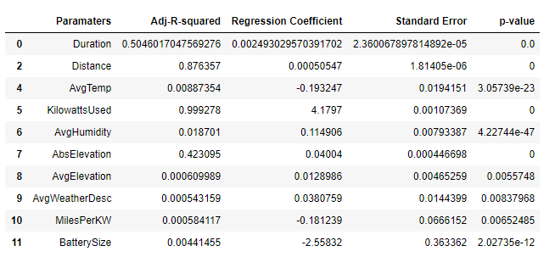
Raw Data
Table1: Raw Data with Charge Used (%) as Dependent Variable

Slide 3
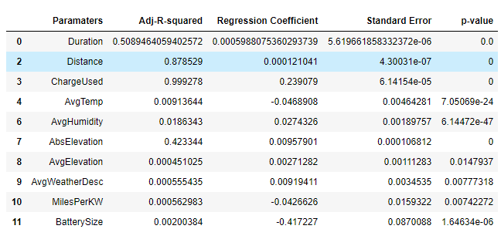
Table2: Raw Data with Kilowatts Used as Dependent Variable

Slide 4
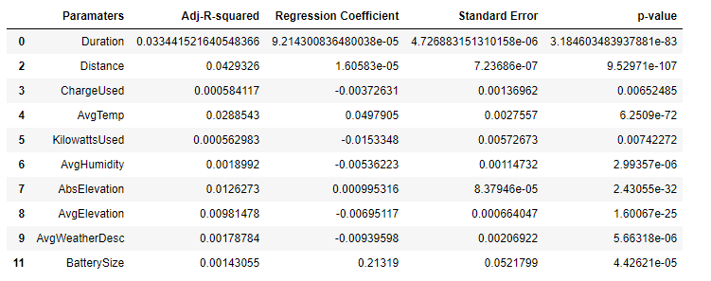
Table3: Raw Data with Miles per Kilowatt Used as Dependent Variable

Slide 5
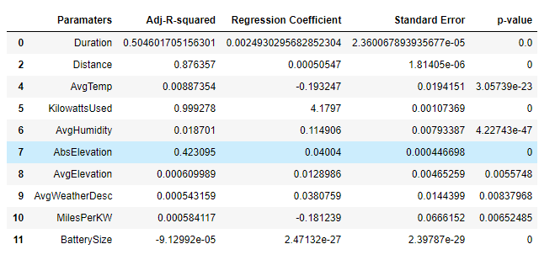
Normalized Data
Table4: Normalized Data with Charge Used (%) as Dependent Variable

Slide 6
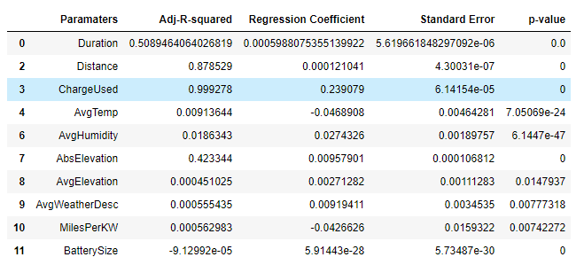
Table5: Normalized Data with Kilowatts Used as Dependent Variable

Slide 7
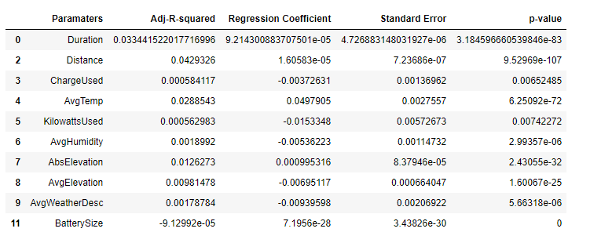
Table6: Normalized Data with Miles per Kilowatt as Dependent Variable

Slide 8
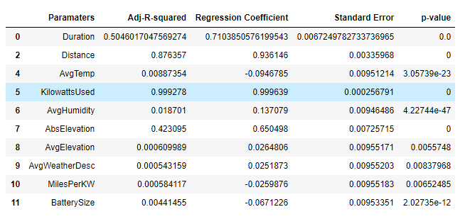
Standardized Data
Table7: Standardized Data with Charge Used (%) as Dependent Variable

Slide 9
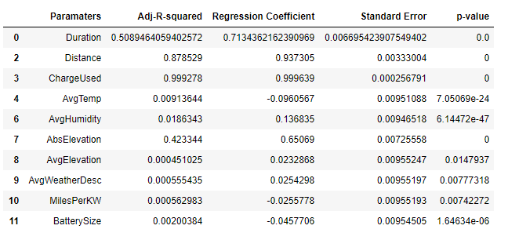
Table8: Standardized Data with Kilowatts Used as Dependent Variable

Slide 10
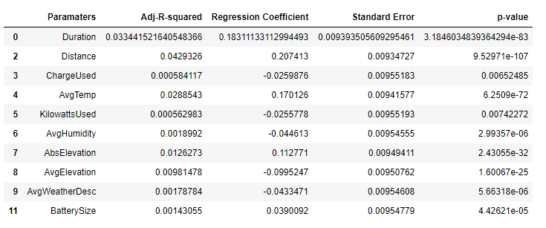
Table9: Standardized Data with Miles per Kilowatt as Dependent Variable

Slide 11
Findings
No change in reported R-square value & p-value when used:-
Raw data
Normalized data
Standardized data
When working with charge used & kilowatts used (as dependent variable), the following parameters had relatively high R-square values (arranged in order of increasing R-square value):-
Absolute elevation
Duration
Distance
When working with miles per kilowatt (as dependent variable), only distance has `acceptable’ R-square value (~0.3).
Rest of parameters have a R-square values <0.1. Only duration & avgtemperature (aside from distance) were reported as having a significant p-value.

Slide 12
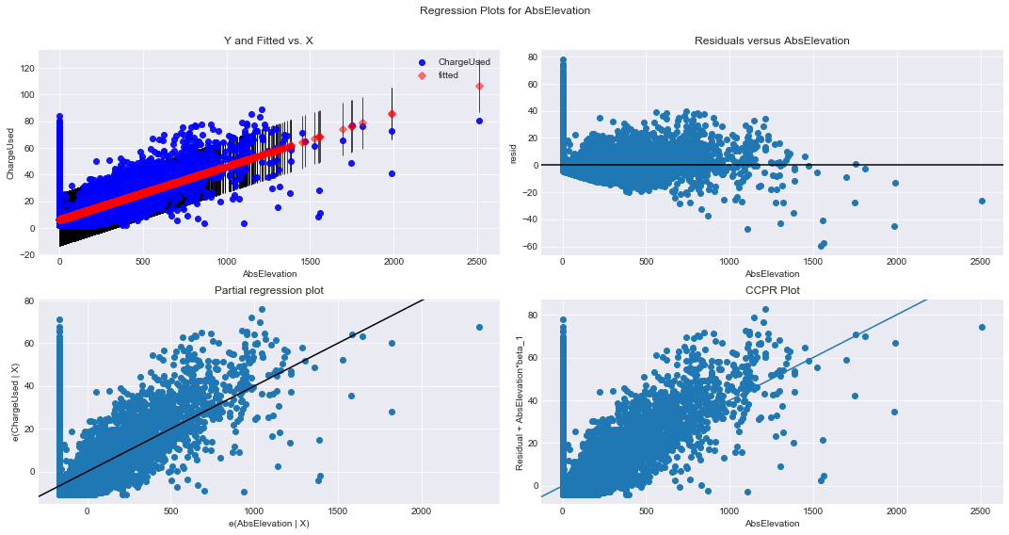
Regression Plots using Raw Data
Section 1 – With Charge Used (%) as the Dependent Variable
Residuals not randomly distributed
Is this a problem? (check with Pri)
Figure1: Regression Plots for Absolute Elevation (m) against Charge Used (%)

Slide 13
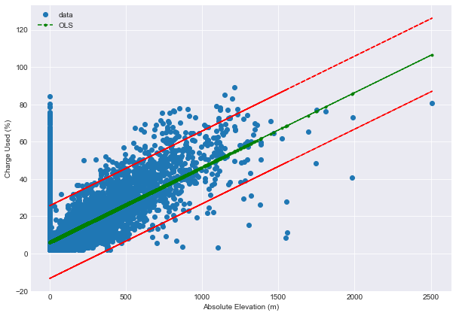
Figure2: Trend Line Plot of Absolute Elevation(m) against Charge Used(%)
Appears to have clustering on left side of graph (@ low absolute elevation) = same pattern seen in residual plot
Is this problematic? (ask Pri)

Slide 14
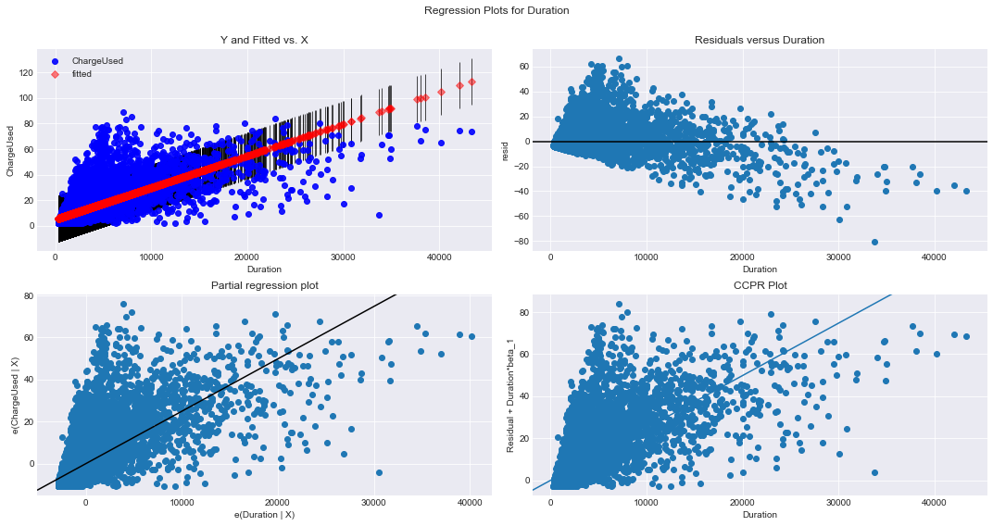
Residuals not randomly distributed
Is this a problem? (check with Pri)
Figure3: Regression Plots for Duration(s) against Charge Used (%)

Slide 15
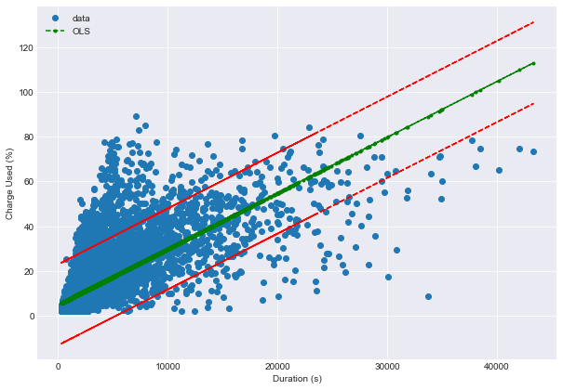
Figure4: Trend Line Plot of Duration(s) against Charge Used(%)
Appears to have clustering on left side of graph (@ low absolute duration levels) = same pattern seen in residual plot
Is this problematic? (ask Pri)

Slide 16
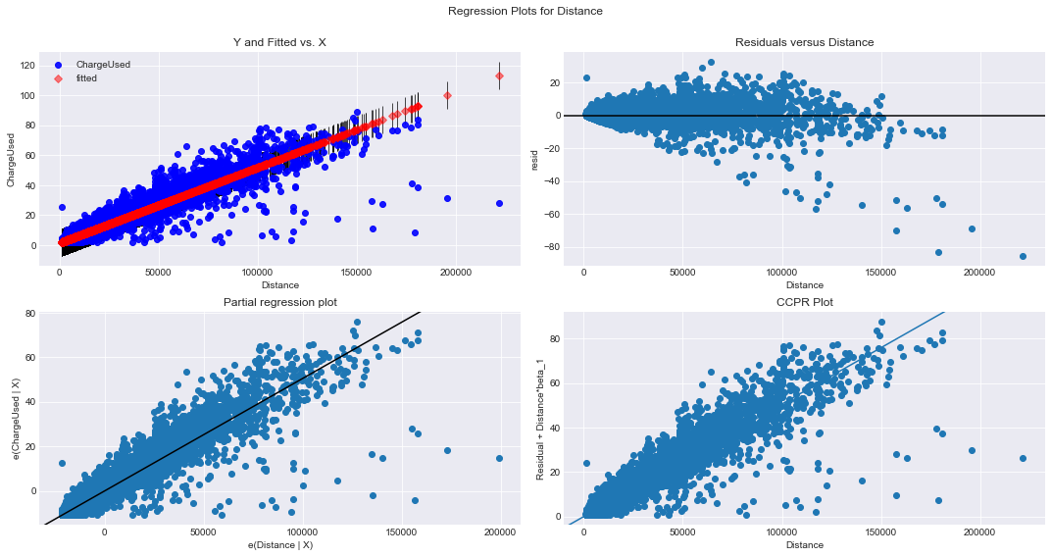
Residuals roughly randomly distributed
Is this now ok?
Figure5: Regression Plots for Distance(m) against Charge Used (%)

Slide 17
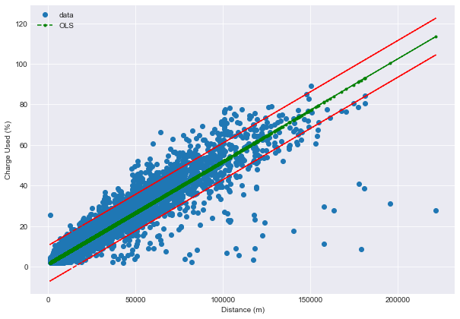
Figure6: Trend Line Plot of Distance(m) against Charge Used(%)
Quite good clustering of data points around the trend line (most within the confidence interval)
Can this be improved upon? => use multiple linear regression

Slide 18
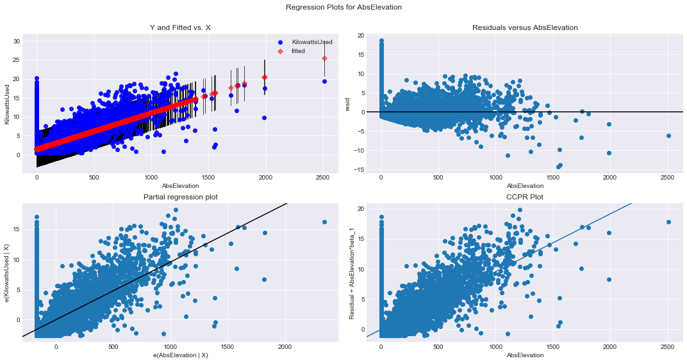
Section 2 – With Kilowatts Used (kW) as the Dependent Variable
Residuals not randomly distributed
Is this a problem? (check with Pri)
Figure7: Regression Plots for Absolute Elevation(m) against Kilowatts Used (kW)
Same pattern seen when using charged used (%) as the dependent variable
, not surprising as they’re the same thing

Slide 19
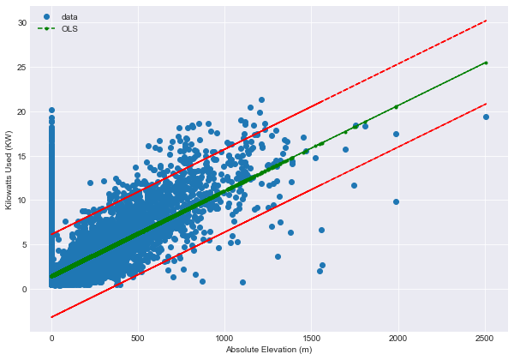
Figure8: Trend Line Plot of Absolute Elevation(m) against Kilowatts Used(kW)
Same pattern seen when plot absolute elevation against charged used (%), with clustering of points on the left
Is this problematic? (ask Pri)

Slide 20
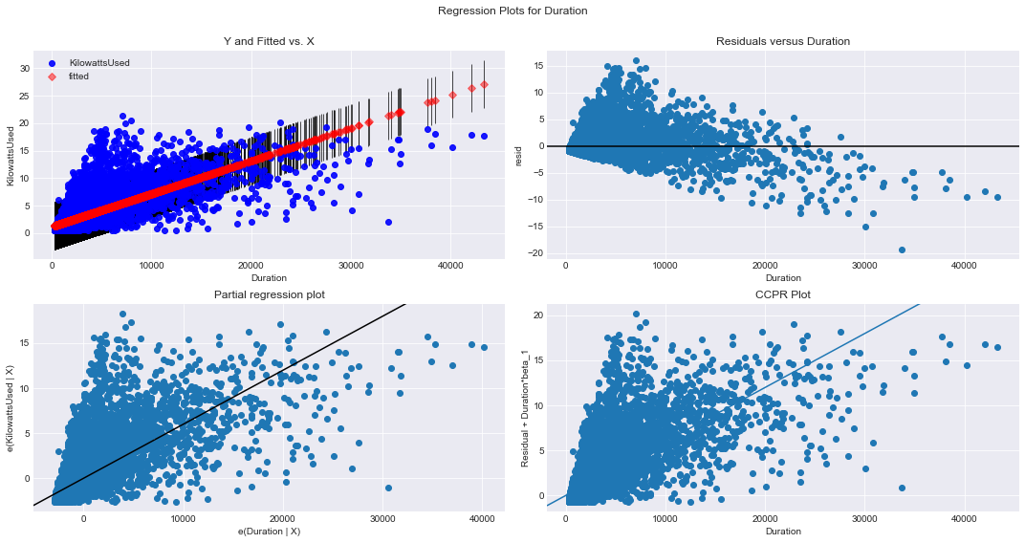
Residuals not randomly distributed
Is this a problem? (check with Pri)
Figure9: Regression Plots for Duration(s) against Kilowatts Used (kW)
Same pattern seen when using charged used (%) as the dependent variable
, not surprising as they’re the same thing

Slide 21
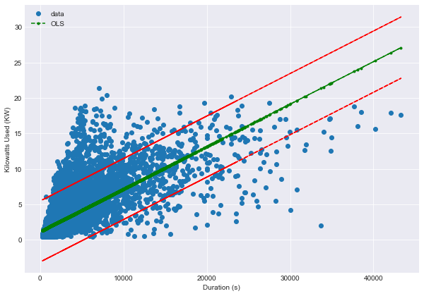
Figure10: Trend Line Plot of Duration(s) against Kilowatts Used(kW)
Same pattern seen when plot absolute elevation against charged used (%), with clustering of points on the left
Is this problematic? (ask Pri)

Slide 22
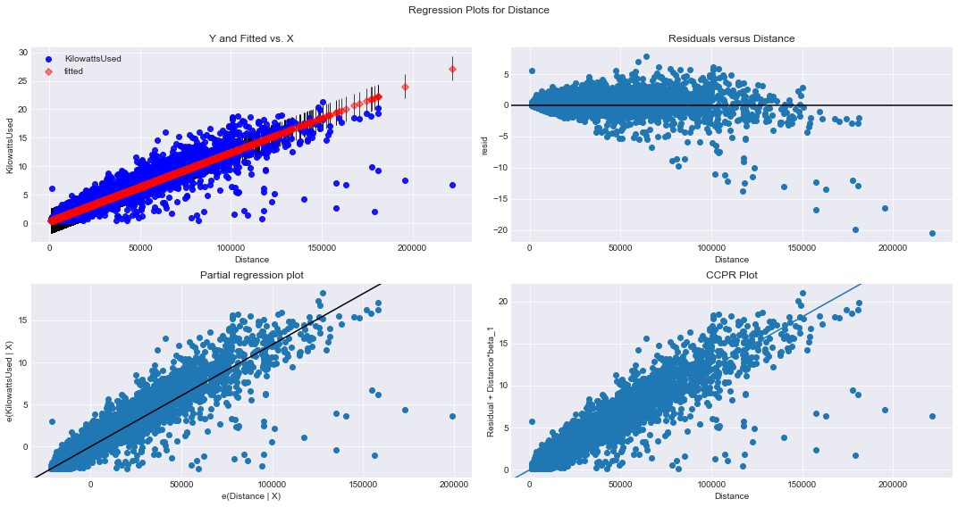
Residuals roughly randomly distributed
Is this now ok?
Figure11: Regression Plots for Distance(m) against Kilowatts Used (kW)
Same pattern seen when using charged used (%) as the dependent variable
, not surprising as they’re the same thing

Slide 23
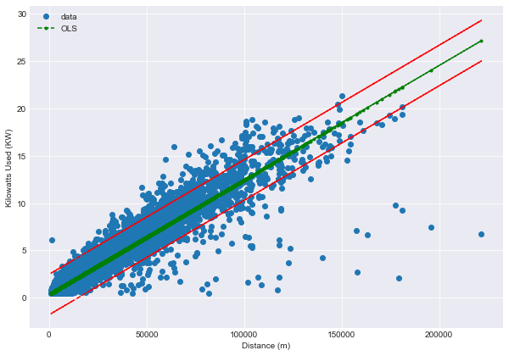
Figure12: Trend Line Plot of Distance(m) against Kilowatts Used(kW)
Quite good clustering of data points around the trend line (most within the confidence interval)
Can this be improved upon? => use multiple linear regression
Same information presented when using charge used (%) as the dependent variable

Slide 24
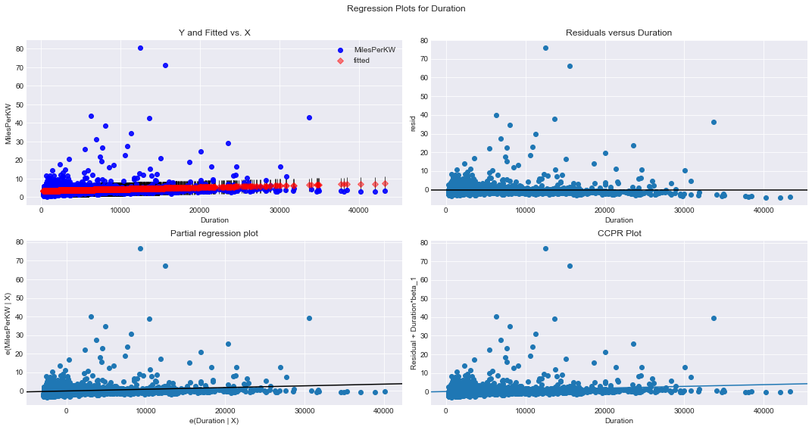
Section 3 – With Miles per Kilowatt (mi/kW) as the Dependent Variable
Figure13: Regression Plots for Duration(s) against Miles per Kilowatt (mi/kW)
Difficult to tell if the residuals are randomly distributed, given the wide range for mi/KW
The residual plot appears to mirror the Y & Fitted vs. x plot. In fact, all 4 plots shown above seem to mirror one another. What does this mean? (ask Pri)

Slide 25
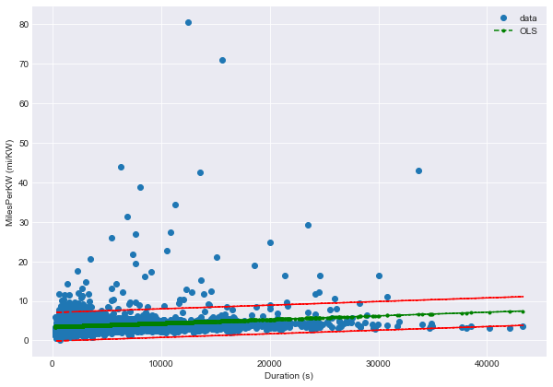
Figure14: Trend Line Plot of Duration(s) against Miles per Kilowatt (mi/kW)
Have tight clustering of data points around trend line, and within confidence intervals.
But what about for outlier data points? Are these actual data or artifacts from errors in data entry/collection?

Slide 26
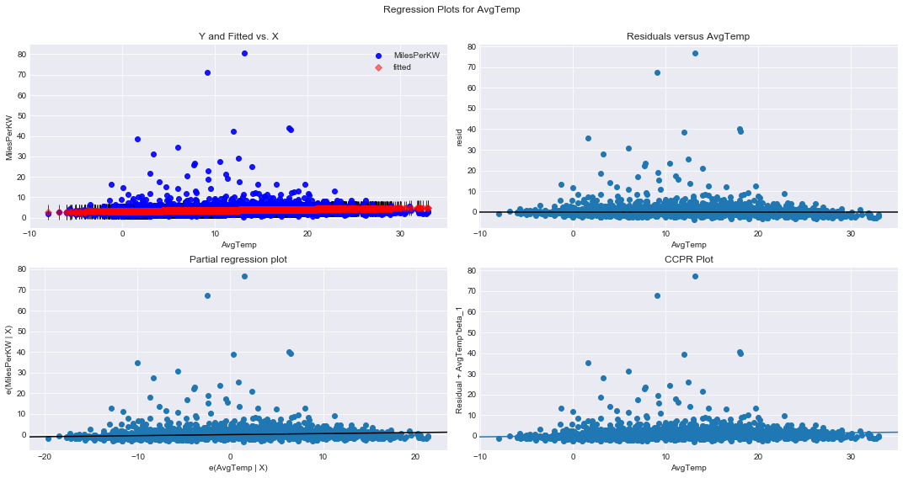
Figure15: Regression Plots for Average Temperature against Miles per Kilowatt (mi/kW)
Same problems exhibited here as those found when used duration as the independent variable:-
Unsure if residuals are randomly distributed given the wide range for mi/kW
All 4 plots mirror one another. What does this mean? Was there an error in the way the ordinary least squares
and regression plots were done?

Slide 27
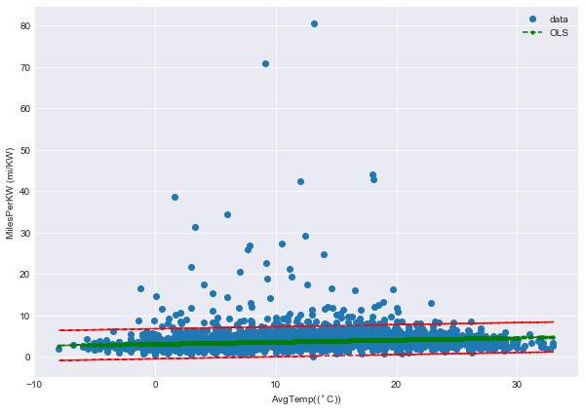
Figure16: Trend Line Plot of Average Temperature against Miles per Kilowatt (mi/kW)
Have tight clustering of data points around trend line, and within confidence intervals.
But what about for outlier data points? Are these actual data or artifacts from errors in data entry/collection?

Slide 28
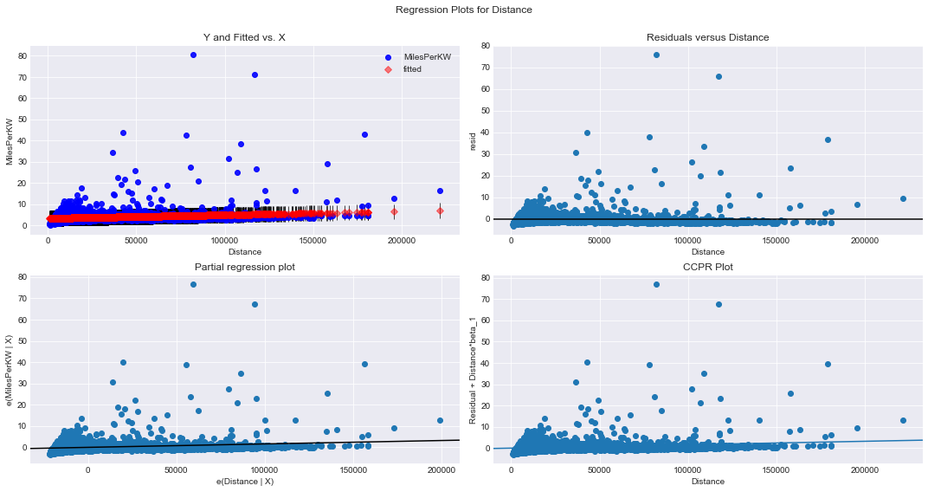
Figure17: Regression Plots for Distance(m) against Miles per Kilowatt (mi/kW)
Same problems exhibited here as those found when used duration (or average temperature) as the independent variable:-
Unsure if residuals are randomly distributed given the wide range for mi/kW
All 4 plots mirror one another. What does this mean? Was there an error in the way the ordinary least squares
and regression plots were done?

Slide 29
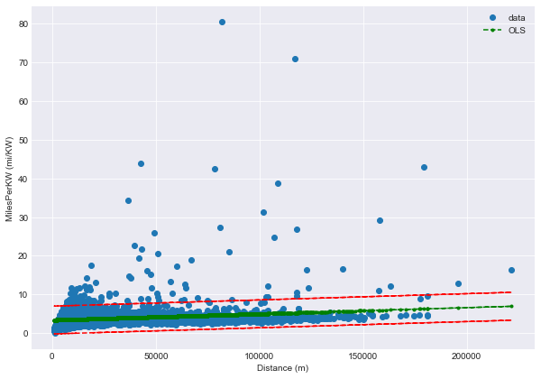
Figure16: Trend Line Plot of Distance (m) against Miles per Kilowatt (mi/kW)
Have tight clustering of data points around trend line, and within confidence intervals.
But what about for outlier data points? Are these actual data or artifacts from errors in data entry/collection?

Slide 30
Brief Summary of Regression Plot Data (only using Raw Data form)
Regression plots & trend lines using charge used (%) and kilowatts used (kW) as dependent variables:-
Since charge used (%) and kilowatts used (kW) are the same dependent variable (expressed in different units), they have the same parameters that are found to have a significant p-value and high R-square value.
Hence, the regression plots and trend lines produced using the same parameters (absolute elevation, duration & distance) against either charge used (%) or kilowatts used (kW) produce the same plots.
For the parameters absolute elevation & duration, the residuals were found to be non-randomly distributed. Both exhibited a clustering of data points on the left hand side of the plot (for both the residual plot and trend line plot)
Is this a bad thing and why does this happen? => Ask Pri
Could it be due to the type of data collected (where most tend to be at low absolute elevations & are short journeys?)
Only the parameter distance had residuals that are roughly randomly distributed. In terms of the trend line plot, most of the data points clustered around the trend line & were contained within the confidence intervals.
Question? => can this be improved upon?
Question? => suggested method for measuring model performance => Ask Pri
Regression plots & trend lines using miles per Kilowatt (mi/kW) as the dependent variable:-
For each regression plot produced for the parameters found to have significant p-values & `high’ R-square values, the 4 regression plot produced for each parameter was found to be essentially the same plot.
Question? => Why is this? + What does this mean? => Ask Pri

Slide 31
Question? => Is there any changes when using a transformed version of the data (normalized/standardized)
Short answer = No (refer to jupyter notebook for full plots)

